Slide 1
9.0 Laplace Transform
9.1 General Principles of Laplace
Transform
Laplace Transform
Eigenfunction Property
x(t) = e^{st}
h(t)
y(t) = H(s)e^{st}
linear time-invariant

Slide 2
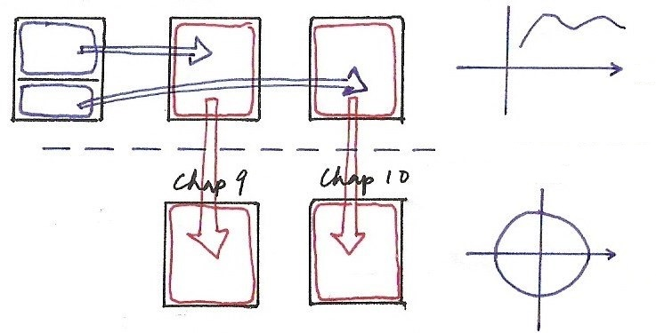


Chapters 3, 4, 5, 9, 10
jω
Chap 9
Chap 3
Chap 4
Chap 5
Chap 10

Slide 3

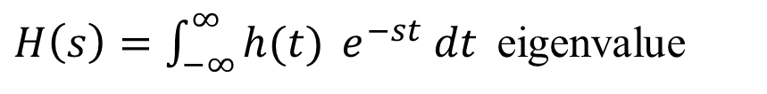

Laplace Transform
Eigenfunction Property
eigenfunction of all linear time-invariant systems with unit impulse response h(t)
applies for all complex variables s
Fourier Transform
Laplace Transform

Slide 4
Laplace Transform
Laplace Transform
A Generalization of Fourier Transform
X(σ + jω)
jω
σ
Fourier transform of

Slide 5
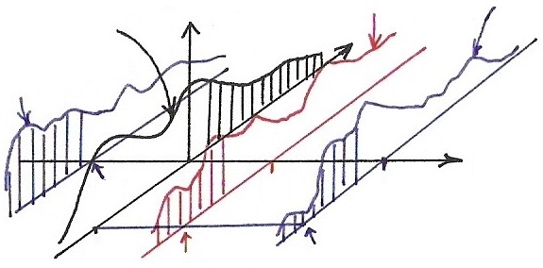







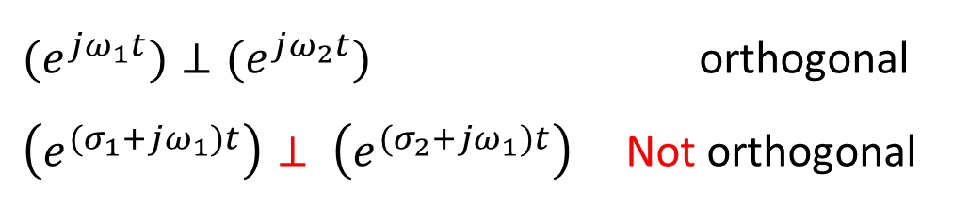






Laplace Transform
$$\left|F[x(t)e^{−σ_{1}t}]\right|$$
$$\left|F[x(t)e^{−σ_{2}t}]\right|$$
$$\left|F[x(t)]\right|$$
$$\left|X(σ+jω)\right|$$
$$\left|F[x(t)e^{−σ_{3}t}]\right|$$
$$σ_{2}+jω_{1}$$

Slide 6
Laplace Transform
A Generalization of Fourier Transform
X(s) may not be well defined (or converged) for all s
X(s) may converge at some region of s-plane, while x(t) doesn’t have Fourier Transform
covering broader class of signals, performing more analysis for signals/systems

Slide 7
Laplace Transform
Rational Expressions and Poles/Zeros
roots zeros
roots poles
Pole-Zero Plots
specifying X(s) except for a scale factor

Slide 8
Laplace Transform
Rational Expressions and Poles/Zeros
Geometric evaluation of Fourier/Laplace transform from pole-zero plots
each term (s-β_{i}) or (s-α_{j}) represented by a vector with magnitude/phase

Slide 9

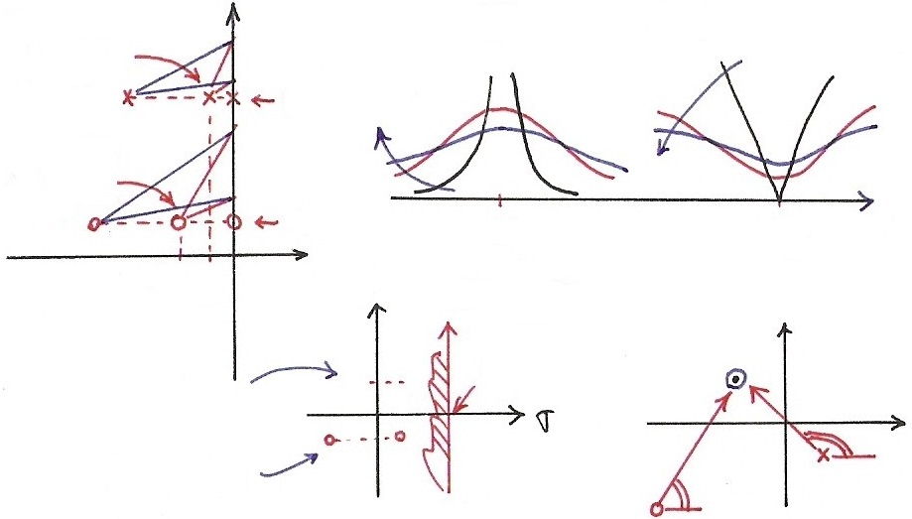

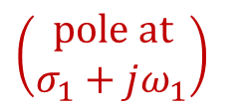


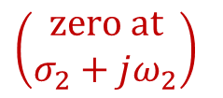














Poles & Zeros
$$\left|X(jω)\right|$$
$$\left|X(σ_{3}+jω)\right|$$
x
x

Slide 10
Region of Convergence (ROC)
Property 1 : ROC of X(s) consists of strips parallel
to the jω -axis in the s-plane
For the Fourier Transform of x(t)e^{-σt} to converge
depending on σ only
Property 2 : ROC of X(s) doesn’t include any poles

Slide 11

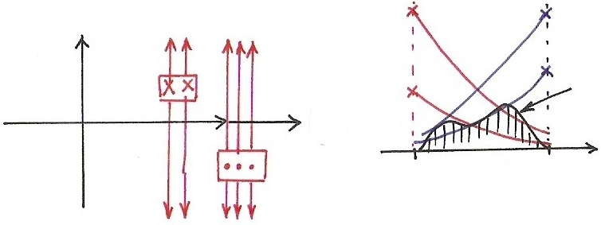





Property 1, 3

Slide 12
Region of Convergence (ROC)
Property 3 : If x(t) is of finite duration and absolutely
integrable, the ROC is the entire s-plane

Slide 13
Region of Convergence (ROC)
Property 4 : If x(t) is right-sided (x(t)=0, t < T₁),
and {s | Re[s] = σ₀}∈ROC, then
{s | Re[s] > σ₀}∈ROC, i.e., ROC
includes a right-half plane

Slide 14

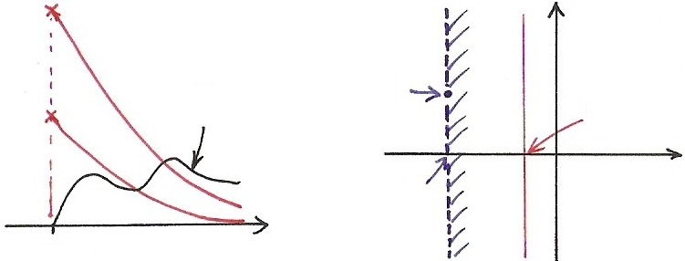







Property 4

Slide 15
Region of Convergence (ROC)
Property 5 : If x(t) is left-sided (x(t)=0, t > T₂),
and {s | Re[s] = σ₀}∈ROC, then
{s | Re[s] < σ₀}∈ROC, i.e., ROC
includes a left-half plane

Slide 16
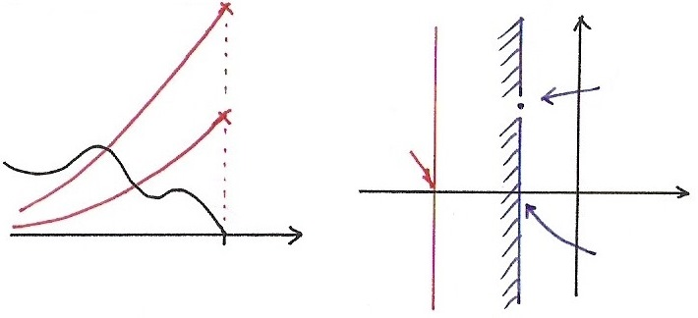






Property 5

Slide 17
Region of Convergence (ROC)
Property 6 : If x(t) is two-sided, and {s | Re[s] =
σ₀}∈ROC, then ROC consists of a strip
in s-plane including {s | Re[s] = σ₀}
See Fig. 9.9, 9.10, p.667 of text
*note: ROC[x(t)] may not exist

Slide 18
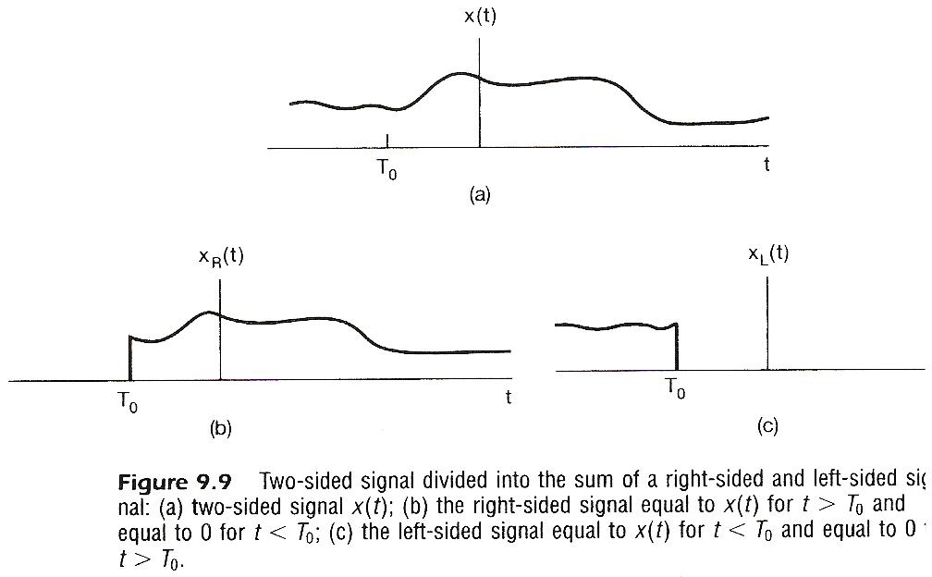

Slide 19
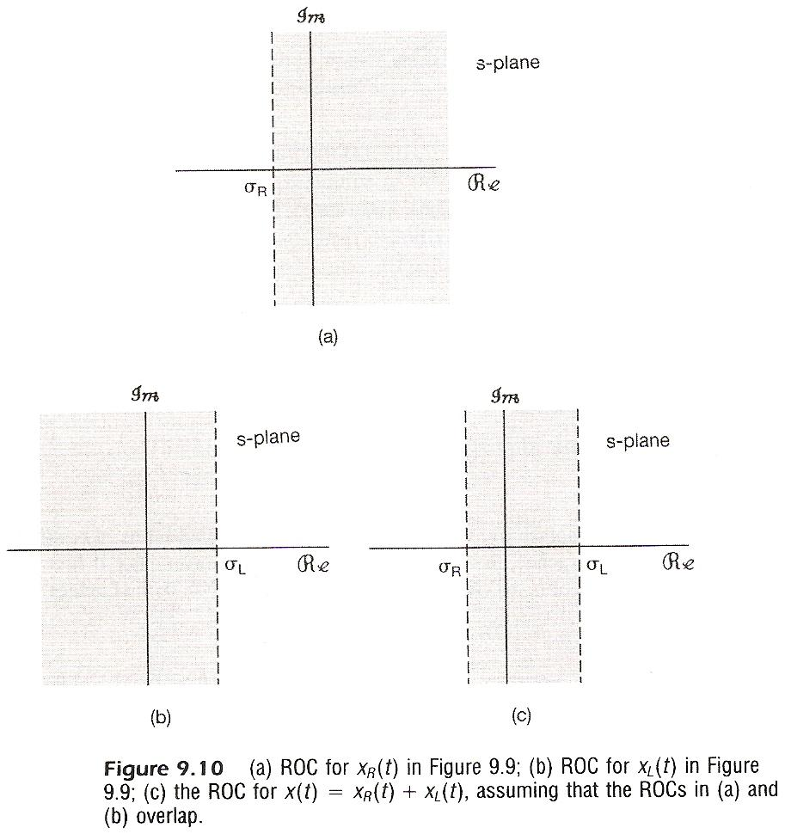

Slide 20
Region of Convergence (ROC)
A signal or an impulse response either doesn’t have a Laplace Transform, or falls into the 4 categories of Properties 3-6. Thus the ROC can be φ, s-plane, left-half plane, right-half plane, or a signal strip

Slide 21
Region of Convergence (ROC)
Property 7 : If X(s) is rational, then its ROC is
bounded by poles or extends to infinity
examples:
See Fig. 9.1, p.658 of text
partial-fraction expansion

Slide 22
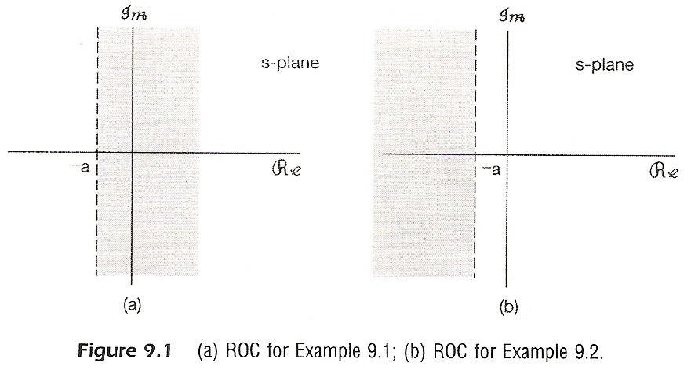

Slide 23
Region of Convergence (ROC)
Property 8 : If x(s) is rational, then if x(t) is right-
sided, its ROC is the right-half plane to
the right of the rightmost pole. If x(t) is
left-sided, its ROC is the left-half plane
to the left of the leftmost pole.

Slide 24

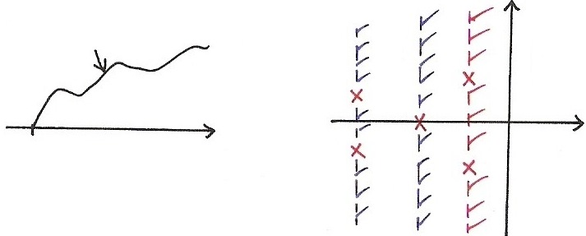




Property 8
ROC

Slide 25
Region of Convergence (ROC)
An expression of X(s) may corresponds to different signals with different ROC’s.
an example:
See Fig. 9.13, p.670 of text
ROC is a part of the specification of X(s)
The ROC of X(s) can be constructed using these properties

Slide 26
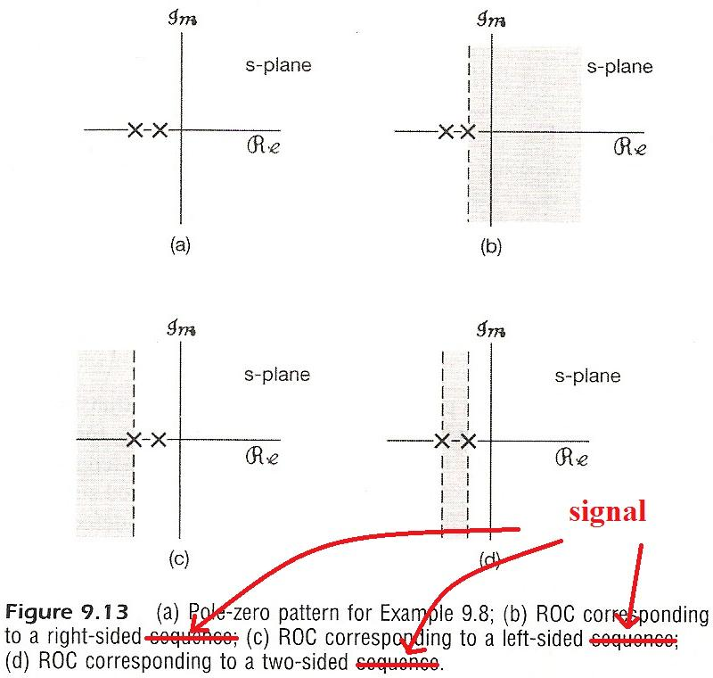

Slide 27
Inverse Laplace Transform
integration along a line {s | Re[s]=σ₁}∈ROC for a fixed σ₁

Slide 28
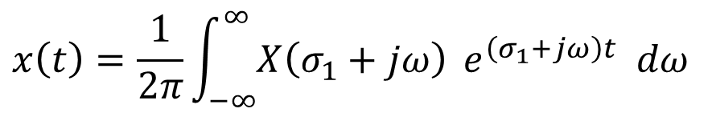
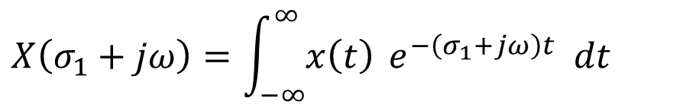

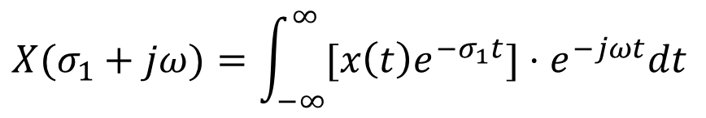
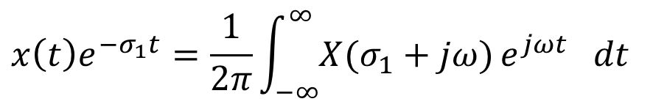


Laplace Transform
X
(basis?)
X
(合成 ?)
X
(分析 ?)
$$≠\vec{A}⋅\vec{v}$$
(分析)
$${\left[e^{\left(σ_{1}+jω\right)t}\right]}^{∗}=e^{σ_{1}t}⋅e^{−jωt}$$
basis
$${x\left(t\right)e}^{{−σ}_{1}t}=\frac{1}{2π}\int_{−∞}^{∞}{X(σ_{1}+jω)}e^{jωt} dt$$
(合成)
$$X(σ_{1}+jω)=\int_{−∞}^{∞}{[x\left(t\right)e^{{−σ}_{1}t}]}⋅e^{−jωt}dt$$
(分析)

Slide 29
Inverse Laplace Transform
Practically in many cases : partial-fraction expansion works
ROC to the right of the pole at s = -a_{i}
ROC to the left of the pole at s = -a_{i}
Known pairs/properties practically helpful

Slide 30
9.2 Properties of Laplace Transform
Linearity
Time Shift

Slide 31
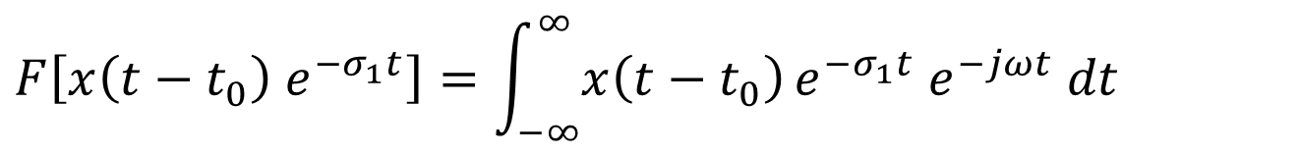
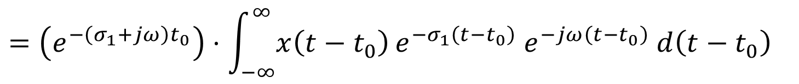
Time Shift
$$=e^{−\left(σ_{1}+jω\right)t_{0}}⋅X(s)|_{s=σ_{1}+jω}={[e^{−st_{0}}⋅X(s)]}_{s=σ_{1}+jω}$$

Slide 32
Shift in s-plane
See Fig. 9.23, p.685 of text
for s₀ = jω₀
shift along the jω axis

Slide 33

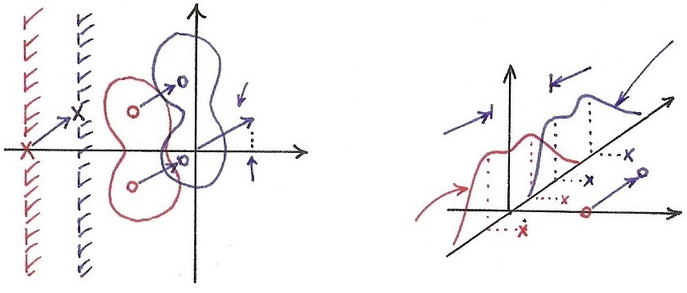










Shift in s-plane
$$s_{0}=jω_{0}$$
$$\left|X(j\left(ω−ω_{0}\right))\right|$$
$$\left|X(σ+jω)\right|$$
$$Re[s_{0}]$$
$$\left|X(jω)\right|$$

Slide 34
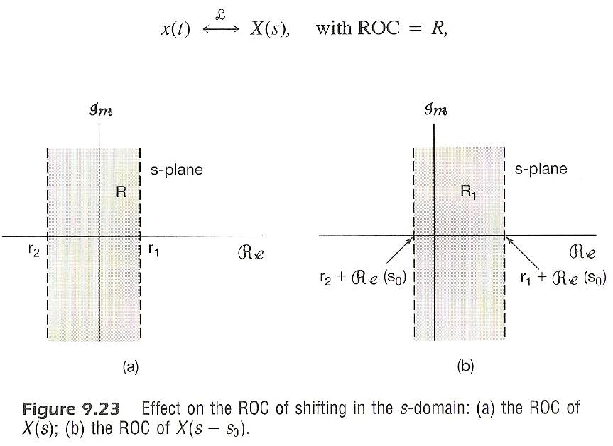

Slide 35
Time Scaling (error on text corrected in class)
Expansion (?) of ROC if a > 1
Compression (?) of ROC if 1 > a > 0
reversal of ROC about jw-axis if a < 0
(right-sided → left-sided, etc.)
See Fig. 9.24, p.686 of text

Slide 36
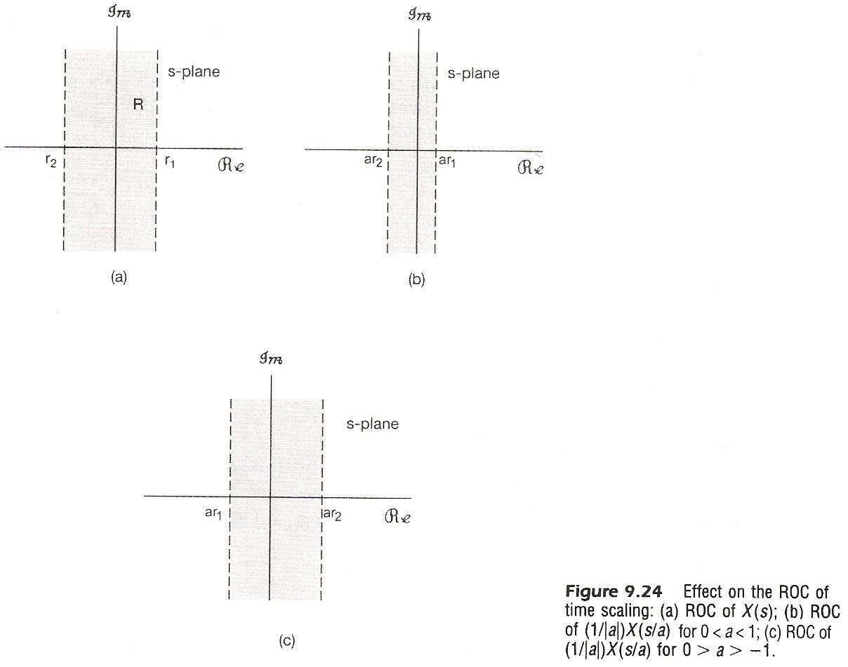

Slide 37
Conjugation
if x(t) is real, and X(s) has a pole/zero at
then X(s) has a pole/zero at
Convolution
ROC may become larger if pole-zero cancellation occurs

Slide 38
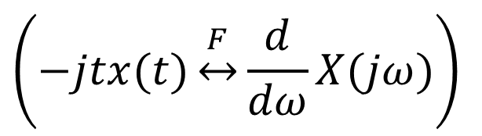
Differentiation
ROC may become larger if a pole at s = 0 cancelled
$$\left(−jtx(t)\underset{↔}{F}\frac{d}{dω}X(jω)\right)$$

Slide 39
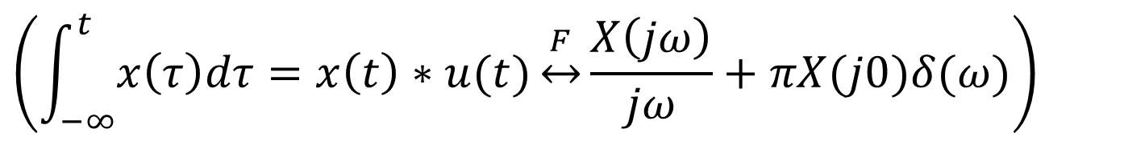
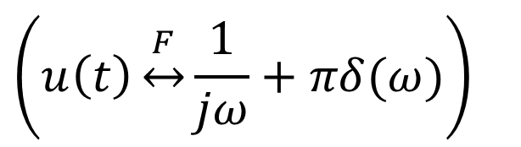
Integration in time Domain
$$\left(\int_{−∞}^{t}{x\left(τ\right)dτ}=x\left(t\right)∗u(t)\underset{↔}{F}\frac{X\left(jω\right)}{jω}+πX(j0)δ(ω)\right)$$
$$\left(u\left(t\right)\underset{↔}{F}\frac{1}{jω}+πδ(ω)\right)$$

Slide 40
Initial/Final – Value Theorems
x(t) = 0, t < 0
x(t) has no impulses or higher order singularities at t = 0
Tables of Properties/Pairs
See Tables 9.1, 9.2, p.691, 692 of text

Slide 41
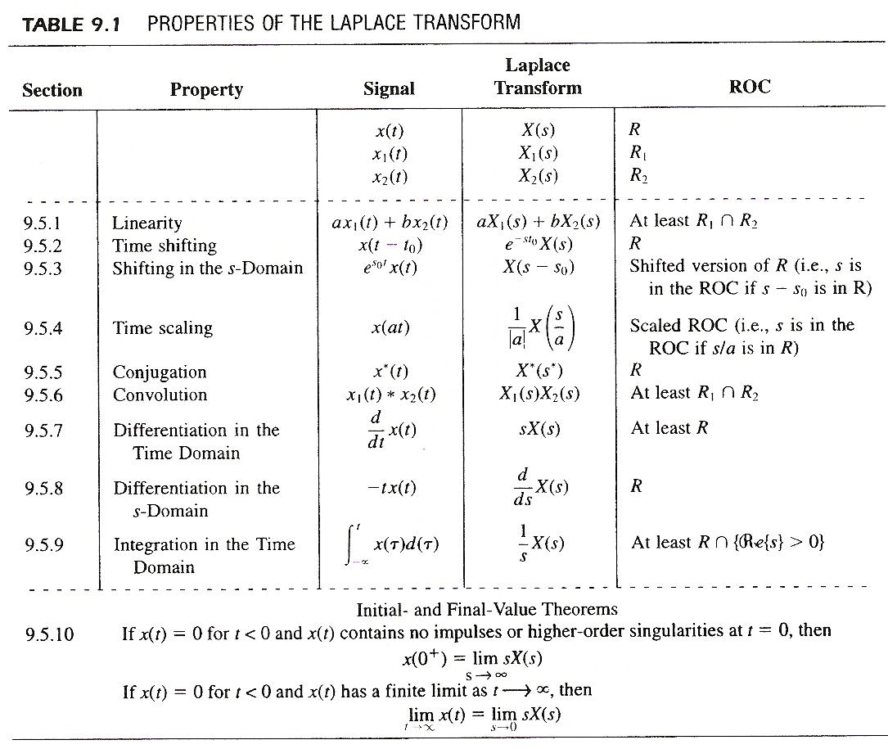

Slide 42
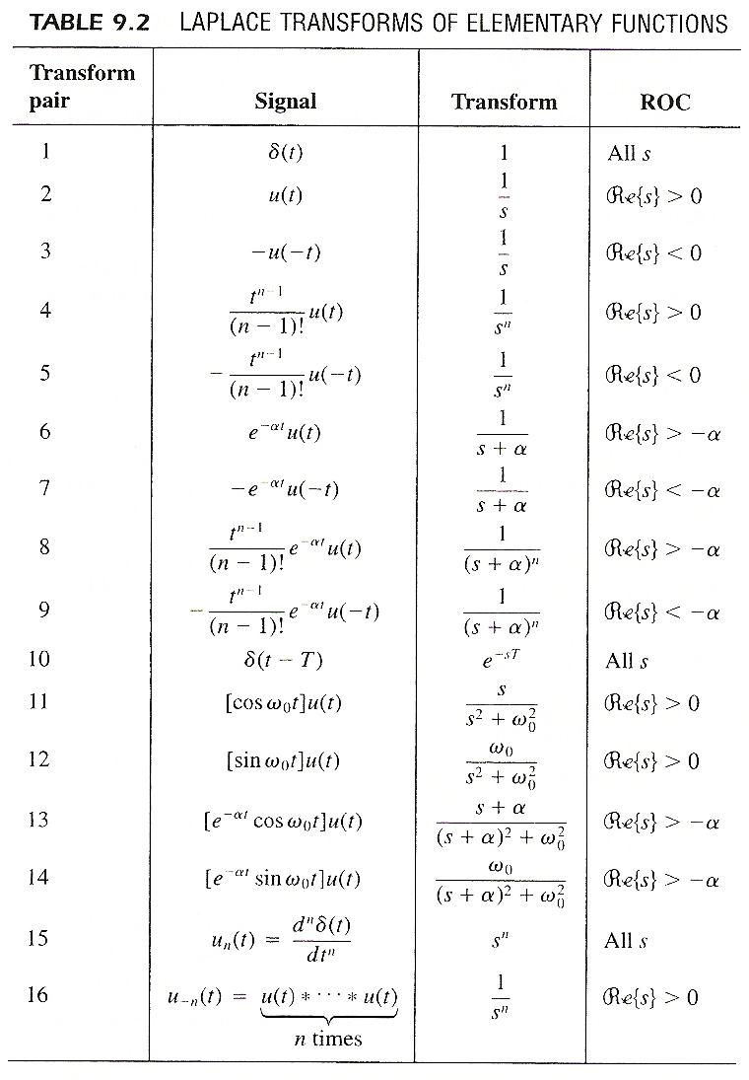

Slide 43
9.3 System Characterization with
Laplace Transform
x(t)
y(t)=x(t)＊h(t)
h(t)
X(s)
H(s)
Y(s)=X(s)H(s)
system function
transfer function

Slide 44
Causality
A causal system has an H(s) whose ROC is a right-half plane
h(t) is right-sided
For a system with a rational H(s), causality is equivalent to its ROC being the right-half plane to the right of the rightmost pole
Anticausality
a system is anticausal if h(t) = 0, t > 0
an anticausal system has an H(s) whose ROC is a left-half plane, etc.

Slide 45
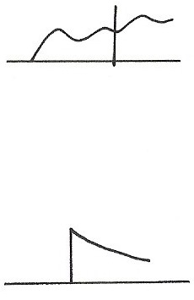





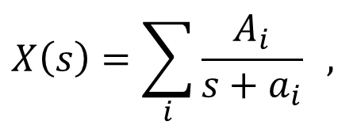
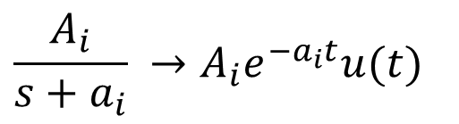
Causality
right-sided
Causal
ROC
is
right half Plane
X
$$X\left(s\right)=\sum_{i}{\frac{A_{i}}{s+a_{i}}} ,$$
$$\frac{A_{i}}{s+a_{i}} →A_{i}e^{−a_{i}t}u(t)$$
Causal

Slide 46
Stability
A system is stable if and only if ROC of H(s) includes the jω -axis
h(t) absolutely integrable, or Fourier transform converges
See Fig. 9.25, p.696 of text
A causal system with a rational H(s) is stable if and only if all poles of H(s) lie in the left-half of s-plane
ROC is to the right of the rightmost pole

Slide 47
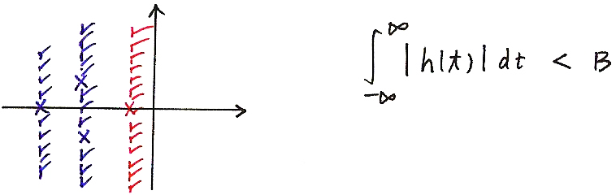
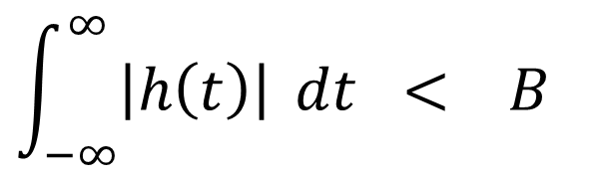
Stability

Slide 48
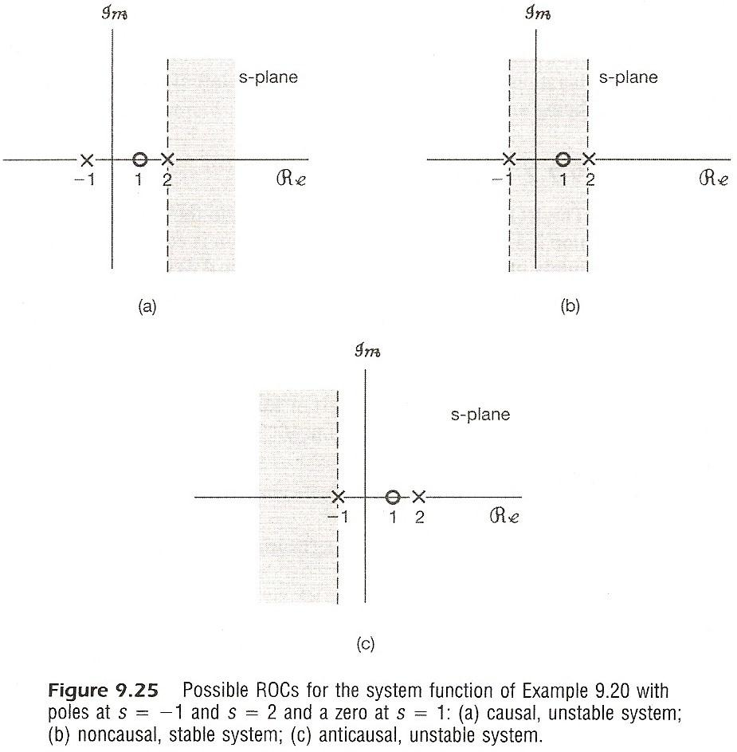

Slide 49
Systems Characterized by Differential Equations
zeros
poles

Slide 50
System Function Algebra
Parallel
h(t) = h₁(t) + h₂(t)
H(s) = H₁(s) + H₂(s)
Cascade
h(t) = h₁(t) ＊ h₂(t)
H(s) = H₁(s)‧ H₂(s)

Slide 51
System Function Algebra
Feedback
x(t)
+
e(t)
h₁(t)
H₁(s)
＋
y(t)
－
z(t)
h₂(t)
H₂(s)

Slide 52
9.4 Unilateral Laplace Transform
impulses or higher order singularities at t = 0
included in the integration

Slide 53
9.4 Unilateral Laplace Transform
ROC for X(s)_{u} is always a right-half plane
a causal h(t) has H(s) = H(s)
two signals differing for t < 0
but identical for t ≥ 0 have identical unilateral Laplace transforms
similar properties and applications

Slide 54
Examples
Example 9.7, p.668 of text

Slide 55
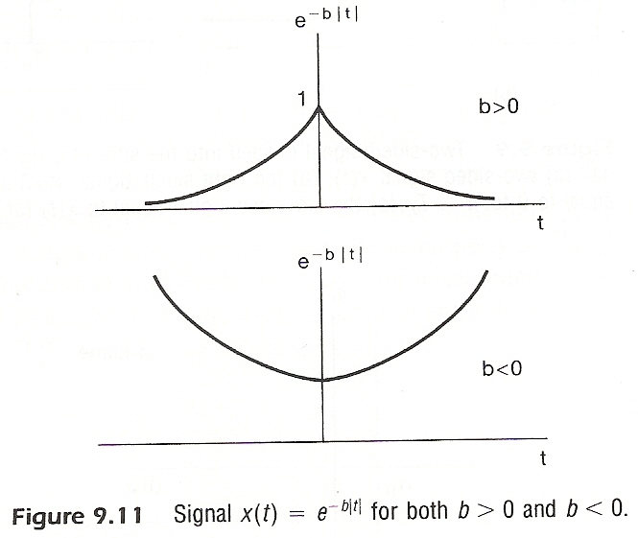
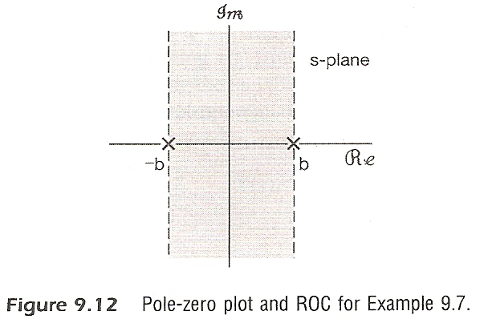
Examples
Example 9.7, p.668 of text

Slide 56
Examples
Example 9.9/9.10/9.11, p.671-673 of text

Slide 57
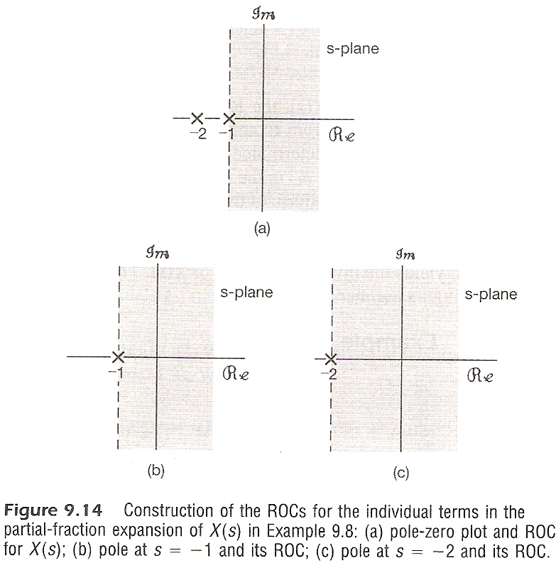
Examples
Example 9.9/9.10/9.11, p.671-673 of text

Slide 58
Examples
Example 9.25, p.701 of text
left-half plane

Slide 59
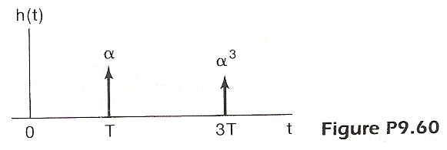
Problem 9.60, p.737 of text
Echo in telephone communication

Slide 60

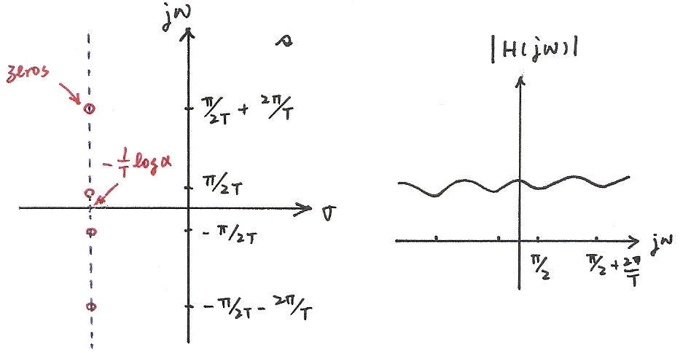











Problem 9.60, p.737 of text
zeros
$$\frac{π}{2T}$$
$$\frac{π}{2T}+\frac{2π}{T}$$

Slide 61
Problem 9.60, p.737 of text

Slide 62
Problem 9.44, p.733 of text

